Slide 1





key generation process in DES
Ujjwal Maity
16800116008

Slide 2
INTRODUCTION
The Data Encryption Standard (DES) is a symmetric-key block cipher published by the National Institute of Standards and Technology (NIST).
6.<number>

Slide 3

Overview
DES is a block cipher, as shown in Figure
Encryption and decryption with DES

Slide 4

DES STRUCTURE
The encryption process is made of two permutations (P-boxes), which we call initial and final permutations, and sixteen Feistel rounds.

Slide 5

Initial and Final Permutations
Initial and final permutation steps in DES

Slide 6

Note
The initial and final permutations are straight P-boxes that are inverses
of each other.
They have no cryptography significance in DES.

Slide 7

Rounds
DES uses 16 rounds. Each round of DES is a Feistel cipher.
A round in DES
(encryption site)

Slide 8

DES Function
The heart of DES is the DES function. The DES function applies a 48-bit key to the rightmost 32 bits to produce a 32-bit output.

Slide 9

Expansion P-box
Since R_{I−1} is a 32-bit input and K_{I} is a 48-bit key, we first need to expand R_{I−1} to 48 bits.

Slide 10
Whitener (XOR)
After the expansion permutation, DES uses the XOR operation on the expanded right section and the round key. Note that both the right section and the key are 48-bits in length. Also note that the round key is used only in this operation.

Slide 11

S-Boxes
The S-boxes do the real mixing (confusion). DES uses 8 S-boxes, each with a 6-bit input and a 4-bit output. See Figure 6.7.

Slide 12

S-box rule

Slide 13
Cipher and Reverse Cipher
Using mixers and swappers, we can create the cipher and reverse cipher, each having 16 rounds.
First Approach
To achieve this goal, one approach is to make the last round (round 16) different from the others; it has only a mixer and no swapper.
Note
In the first approach, there is no swapper in the last round.

Slide 14

DES cipher and reverse cipher for the first approach

Slide 15
Alternative Approach
We can make all 16 rounds the same by including one swapper to the 16th round and add an extra swapper after that (two swappers cancel the effect of each other).

Slide 16

Key Generation
The round-key generator creates sixteen 48-bit keys out of a 56-bit cipher key.

Slide 17
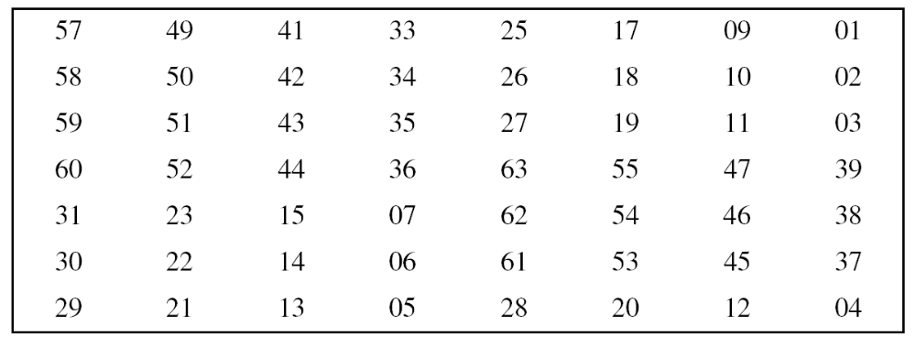
Parity-bit drop table
Number of bits shifts

Slide 18
Strength of DES
Two desired properties of a block cipher are
Avalanche effect
completeness.

Slide 19
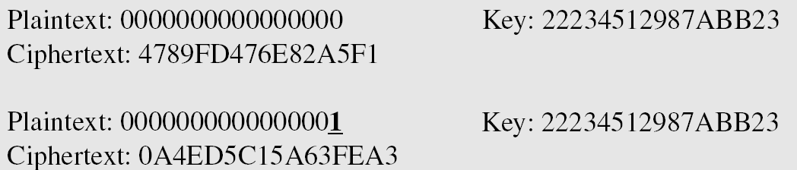
Avalanche effect
A small change in plaintext should create a significant change
in ciphertext
Example
To check the avalanche effect in DES, let us encrypt two plaintext blocks (with the same key) that differ only in one bit and observe the differences in the number of bits in each round.

Slide 20
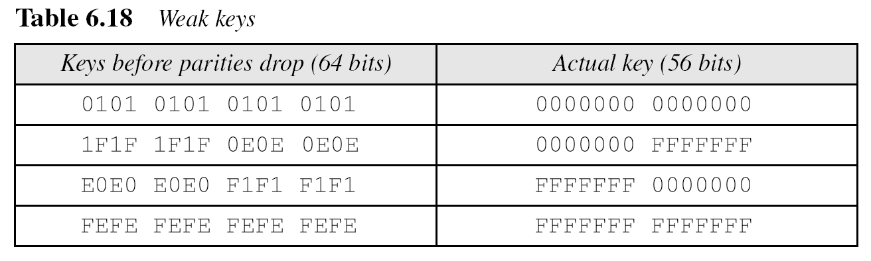
DES Weaknesses
During the last few years critics have found some weaknesses in DES.
Weaknesses in Cipher Design
1. Weaknesses in S-boxes
2. Weaknesses in P-boxes
3. Weaknesses in Key

Slide 21
Thank You

